Slide 1
Numerical Computation for Deep Learning
Lecture slides for Chapter 4 of Deep Learning
www.deeplearningbook.org
Ian Goodfellow
Last modified 2017-10-14
Adapted by m.n. for CMPS 392
Thanks to Justin Gilmer and Jacob Buckman for helpful discussions

Slide 2
Numerical concerns for implementations of deep learning algorithms
Algorithms are often specified in terms of real numbers; real numbers cannot be implemented in a finite computer
Does the algorithm still work when implemented with a finite number of bits?
Do small changes in the input to a function cause large changes to an output?
Rounding errors, noise, measurement errors can cause large changes
Iterative search for best input is difficult

Slide 3
Roadmap
Iterative Optimization
Rounding error, underflow, overflow

Slide 4
Iterative Optimization
Gradient descent
Curvature
Constrained optimization

Slide 5
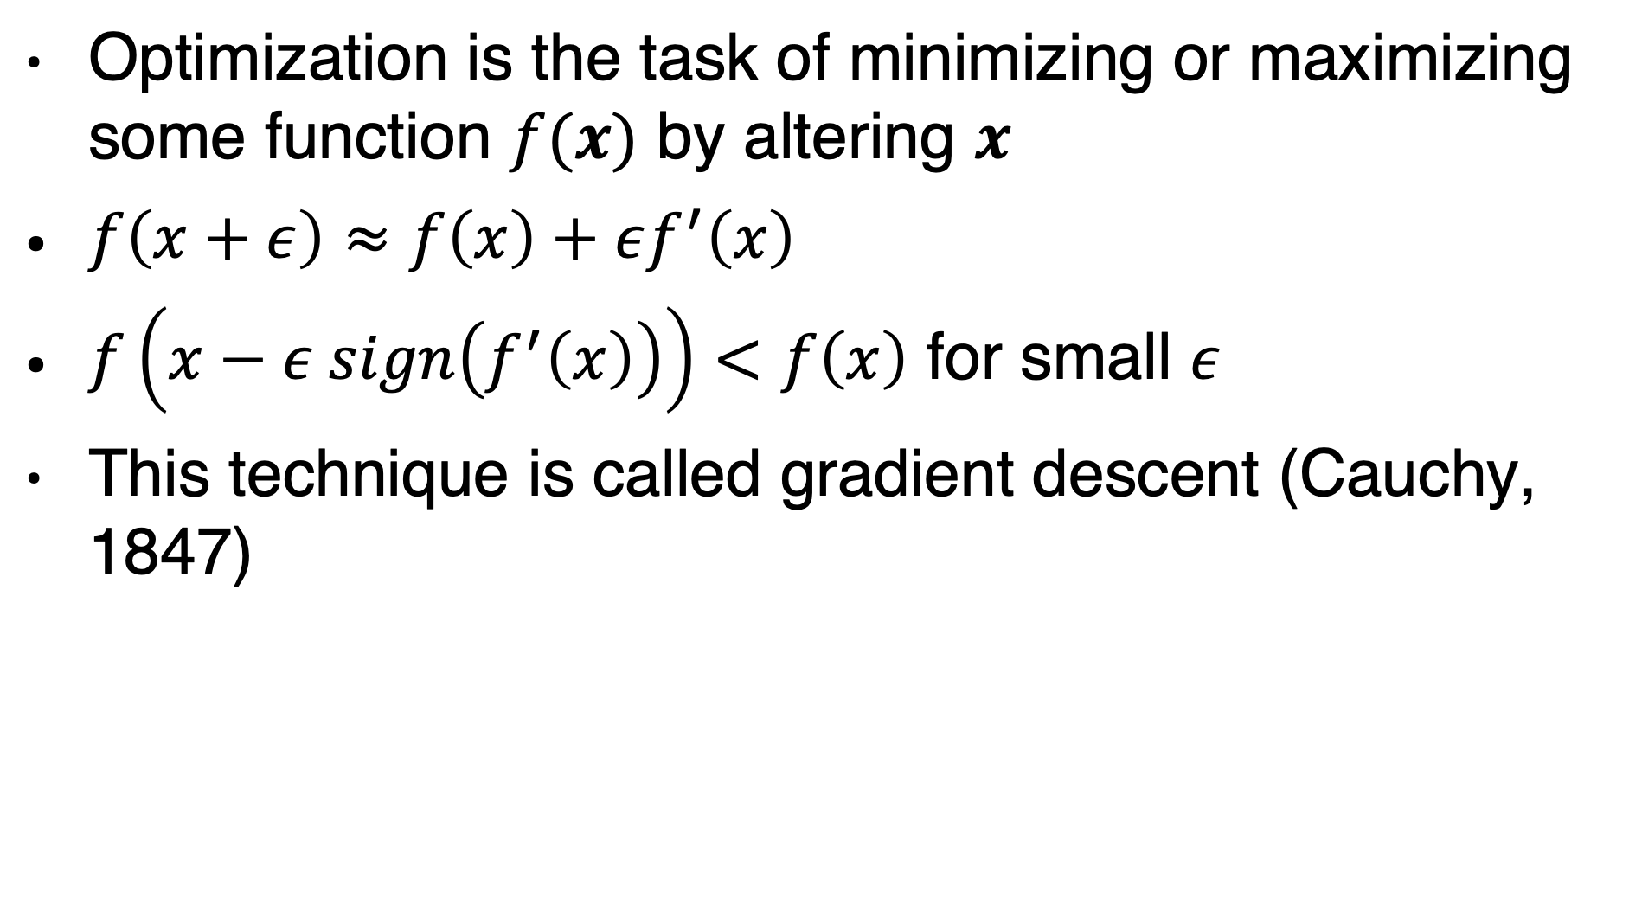
Gradient-based optimization
Optimization is the task of minimizing or maximizing some function $f(x)$ by altering $x$
$f\left(x+ε\right)≈f\left(x\right)+εf^{′}\left(x\right)$
$f\left(x−ε sign\left(f^{′}\left(x\right)\right)\right)<f\left(x\right)$ for small $ε$
This technique is called gradient descent (Cauchy, 1847)

Slide 6
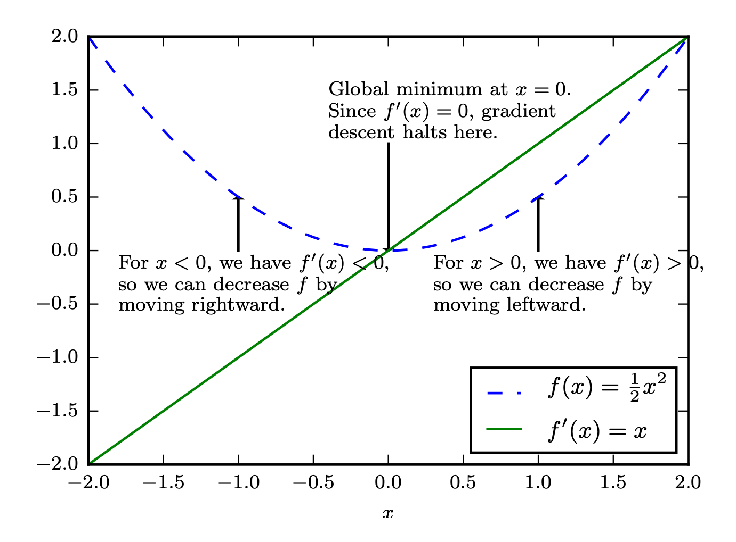
Gradient Descent
Figure 4.1

Slide 7
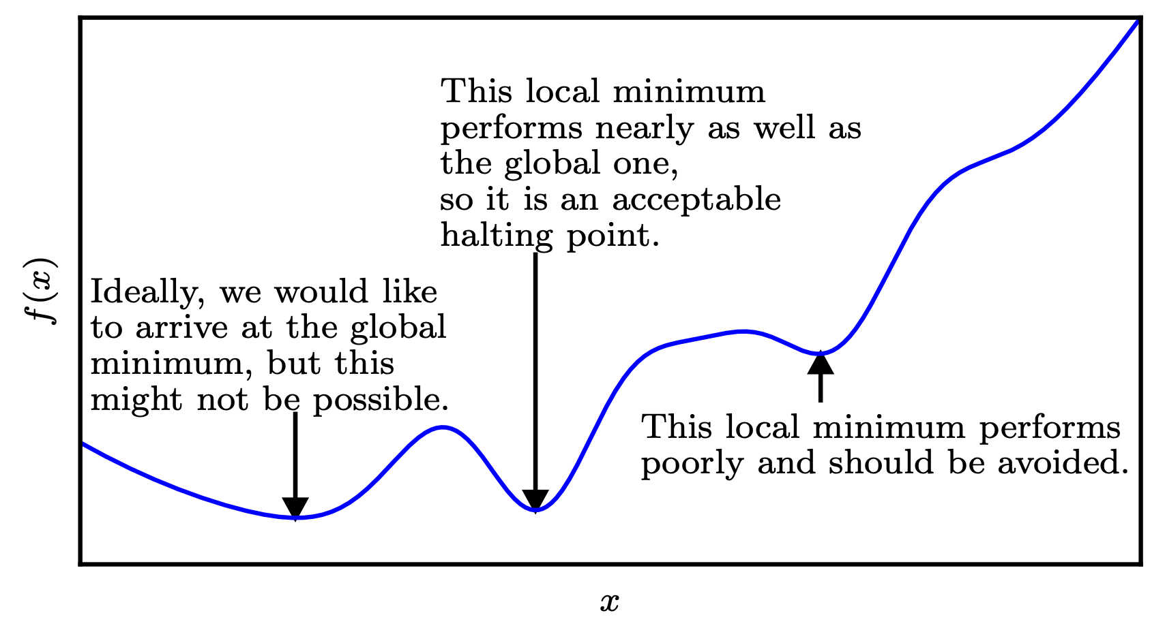
Approximate Optimization
Figure 4.3

Slide 8
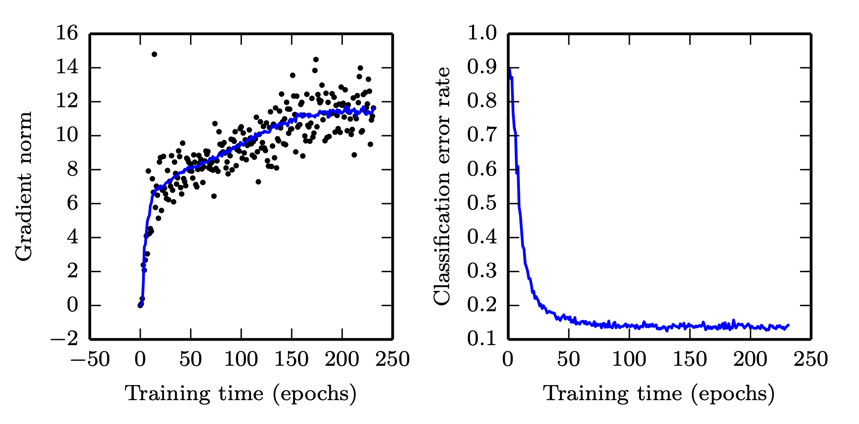
We usually don’t even reach a local minimum

Slide 9
Deep learning optimization way of life
Pure math way of life:
Find literally the smallest value of f(x)
Or maybe: find some critical point of f(x) where the value is locally smallest
Deep learning way of life:
Decrease the value of f(x) a lot

Slide 10
Iterative Optimization
Gradient descent
Curvature
Constrained optimization

Slide 11
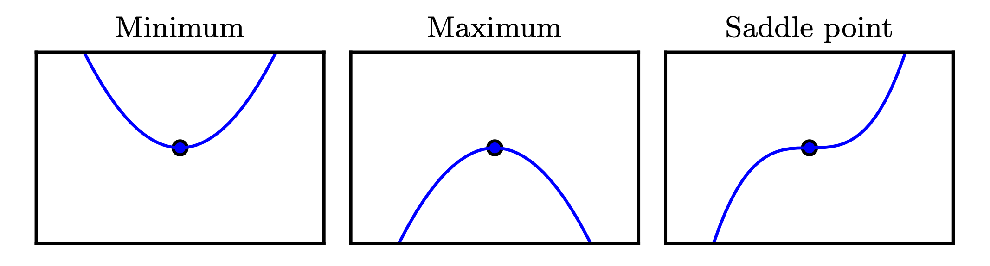
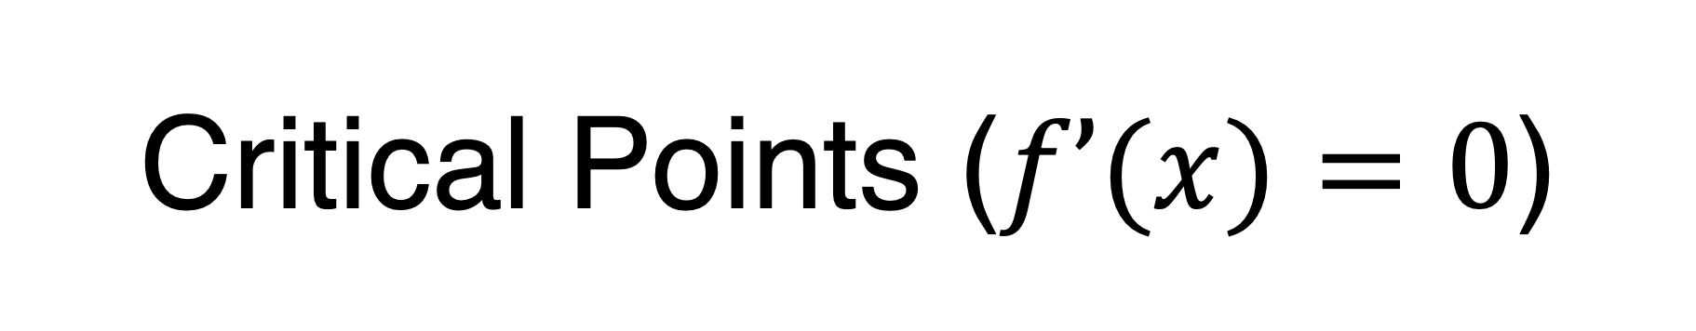
Critical Points ($f’(x)=0$)
Figure 4.2

Slide 12
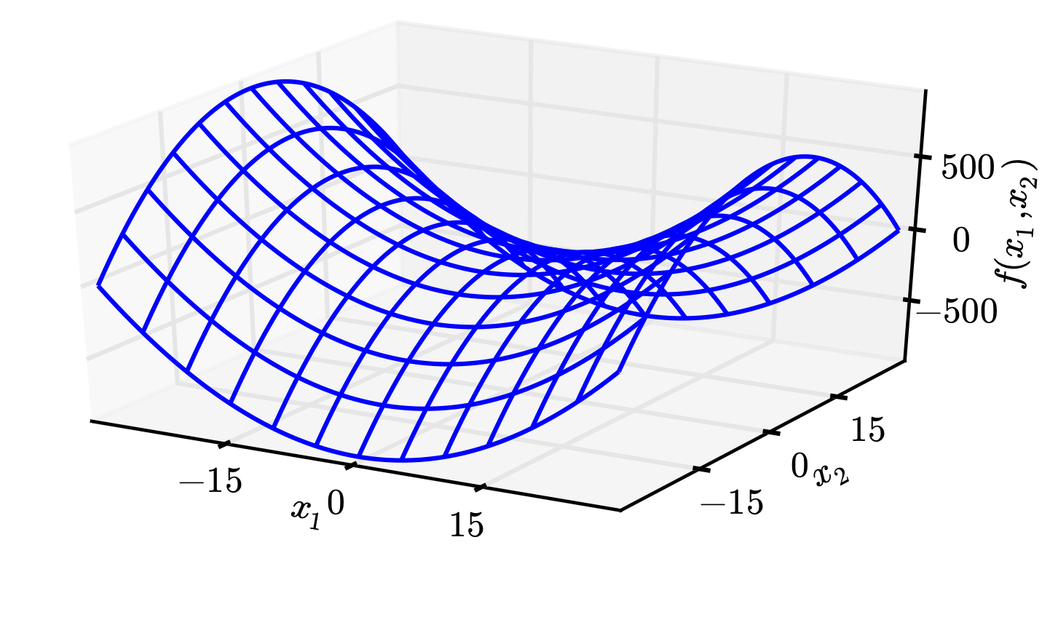
Saddle Points
Figure 4.5
(Gradient descent escapes,
see Appendix C of “Qualitatively Characterizing Neural Network Optimization Problems”)
Saddle points attract Newton’s method

Slide 13
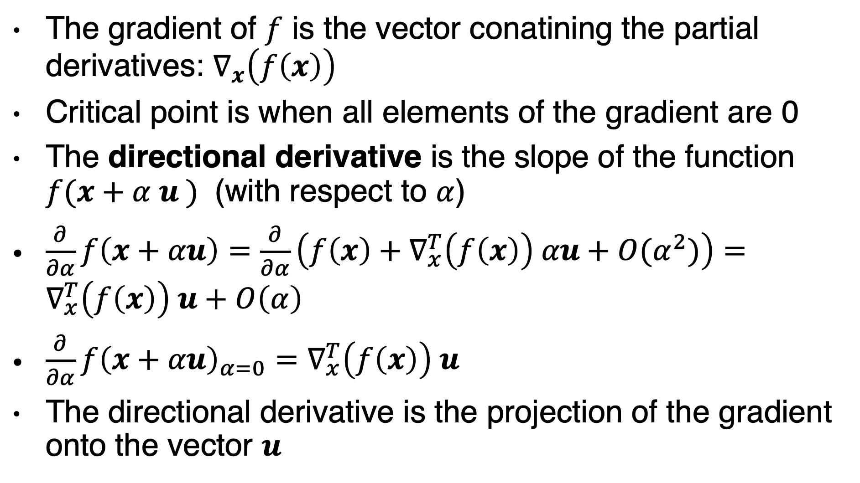
Multiple dimensions
The gradient of $f$ is the vector conatining the partial derivatives: $∇_{x}\left(f\left(x\right)\right)$
Critical point is when all elements of the gradient are 0
The directional derivative is the slope of the function $f(x+α u )$ (with respect to $α$)
$\frac{∂}{∂α}f\left(x+αu\right)=\frac{∂}{∂α}\left(f\left(x\right)+∇_{x}^{T}\left(f\left(x\right)\right) αu+O(α^{2})\right)=∇_{x}^{T}\left(f\left(x\right)\right) u+O\left(α\right)$
$\frac{∂}{∂α}f{\left(x+αu\right)}_{α=0}=∇_{x}^{T}\left(f\left(x\right)\right) u$
The directional derivative is the projection of the gradient onto the vector $u$

Slide 14
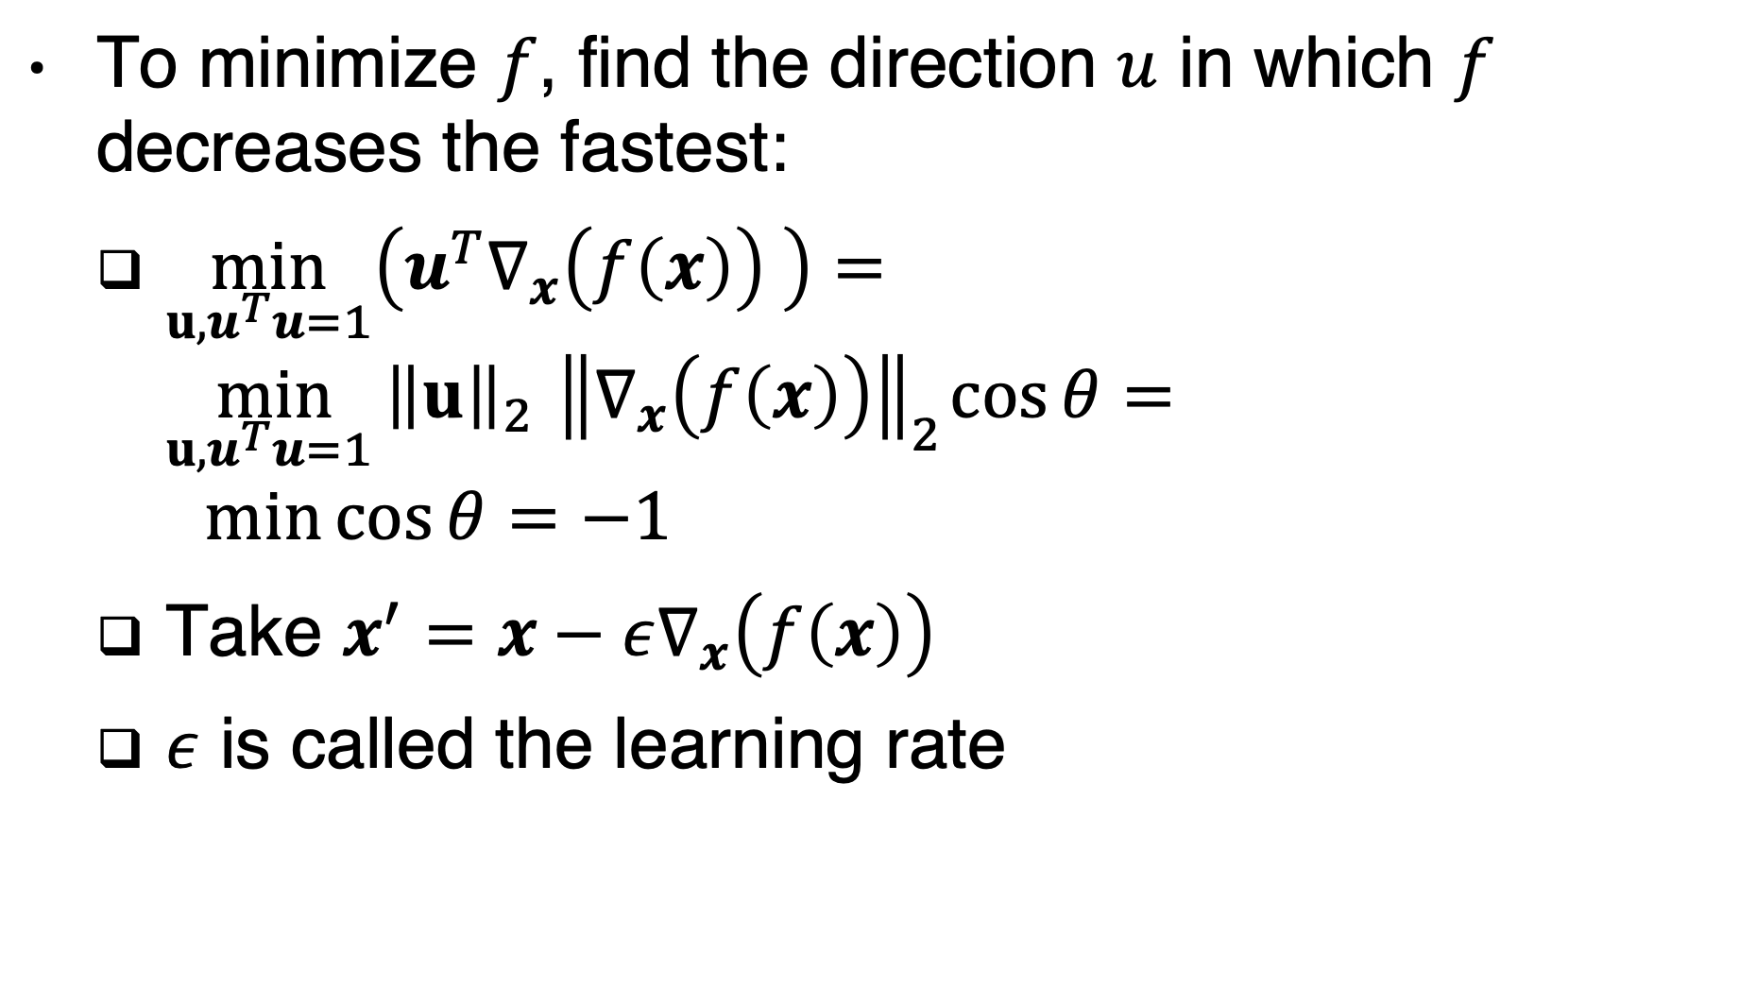
The best u is in the opposite direction of the gradient!
To minimize $f$, find the direction $u$ in which $f$ decreases the fastest:
$\min_{u,u^{T}u=1}\left(u^{T}∇_{x}\left(f\left(x\right)\right) \right)=\min_{u,u^{T}u=1 }{\left\|u\right\|}_{2}{ \left\|∇_{x}\left(f\left(x\right)\right)\right\|}_{2}\cos{θ}=$
$$\min{\cos{θ}}=−1$$
Take $x^{′}=x−ε∇_{x}\left(f\left(x\right)\right)$
$ε$ is called the learning rate

Slide 15
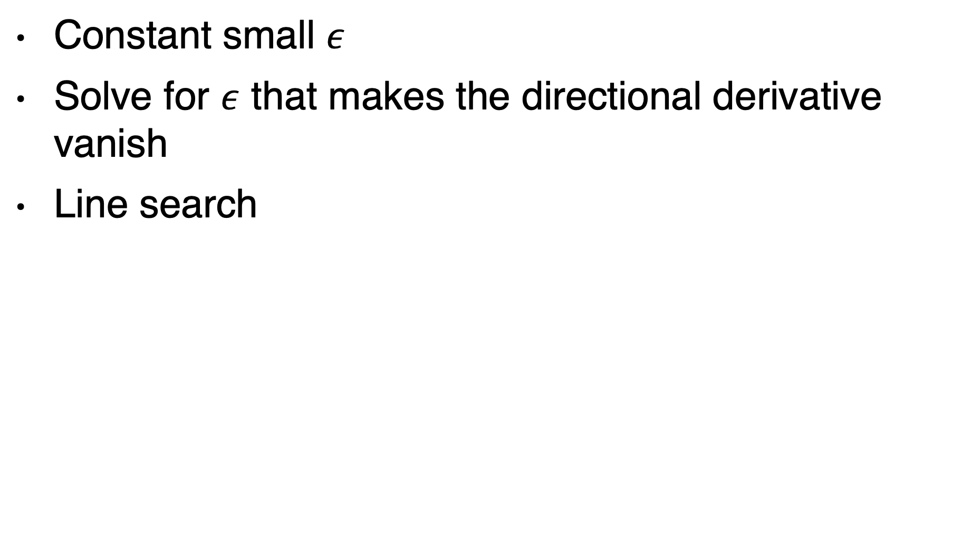

What is the best $ε$ ?
Constant small $ε$
Solve for $ε$ that makes the directional derivative vanish
Line search

Slide 16
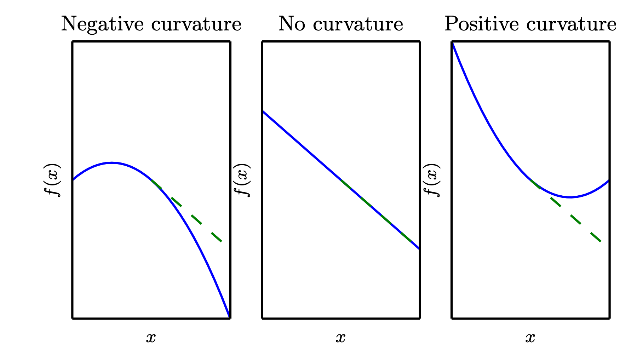
Beyond the gradient: Curvature
The second derivative tells us how the first derviative will change as we vary the input

Slide 17
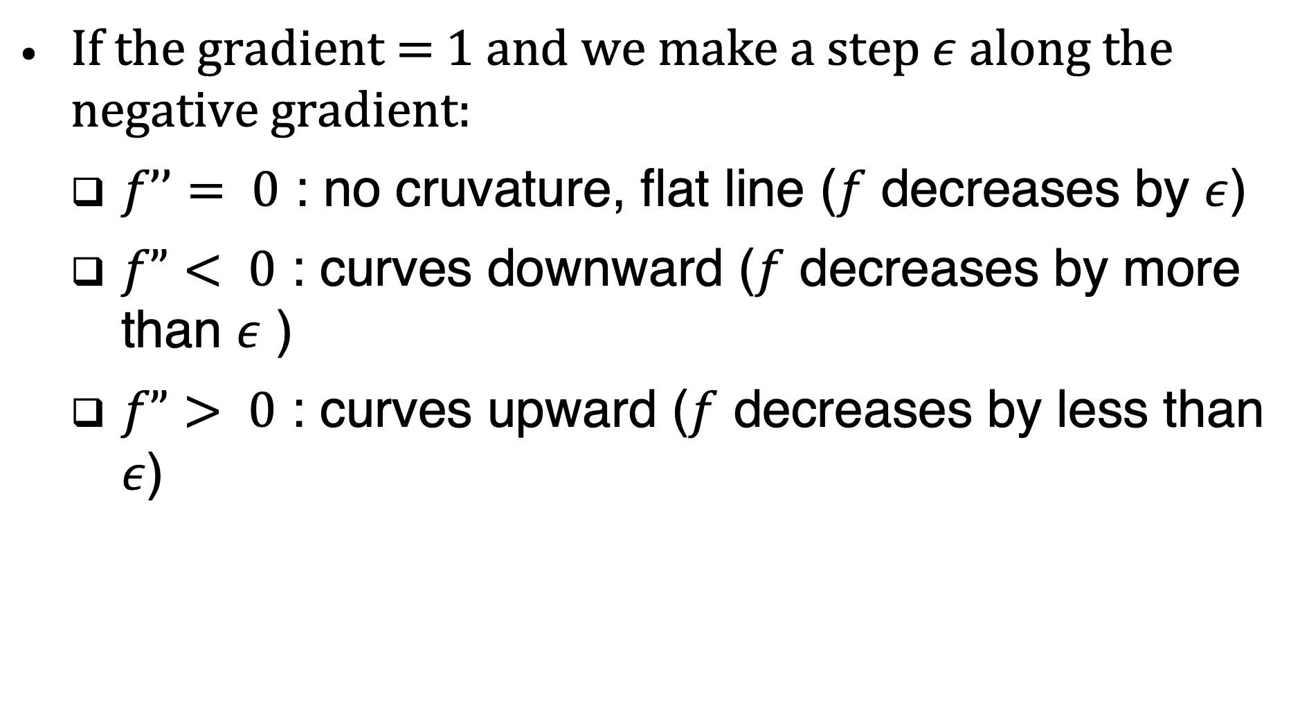
Second derivative
If the gradient = 1 and we make a step $ε$ along the negative gradient:
$f’’= 0$ : no cruvature, flat line ($f$ decreases by $ε$)
$f”< 0$ : curves downward ($f$ decreases by more than $ε$ )
$f”> 0$ : curves upward ($f$ decreases by less than $ε$)

Slide 18
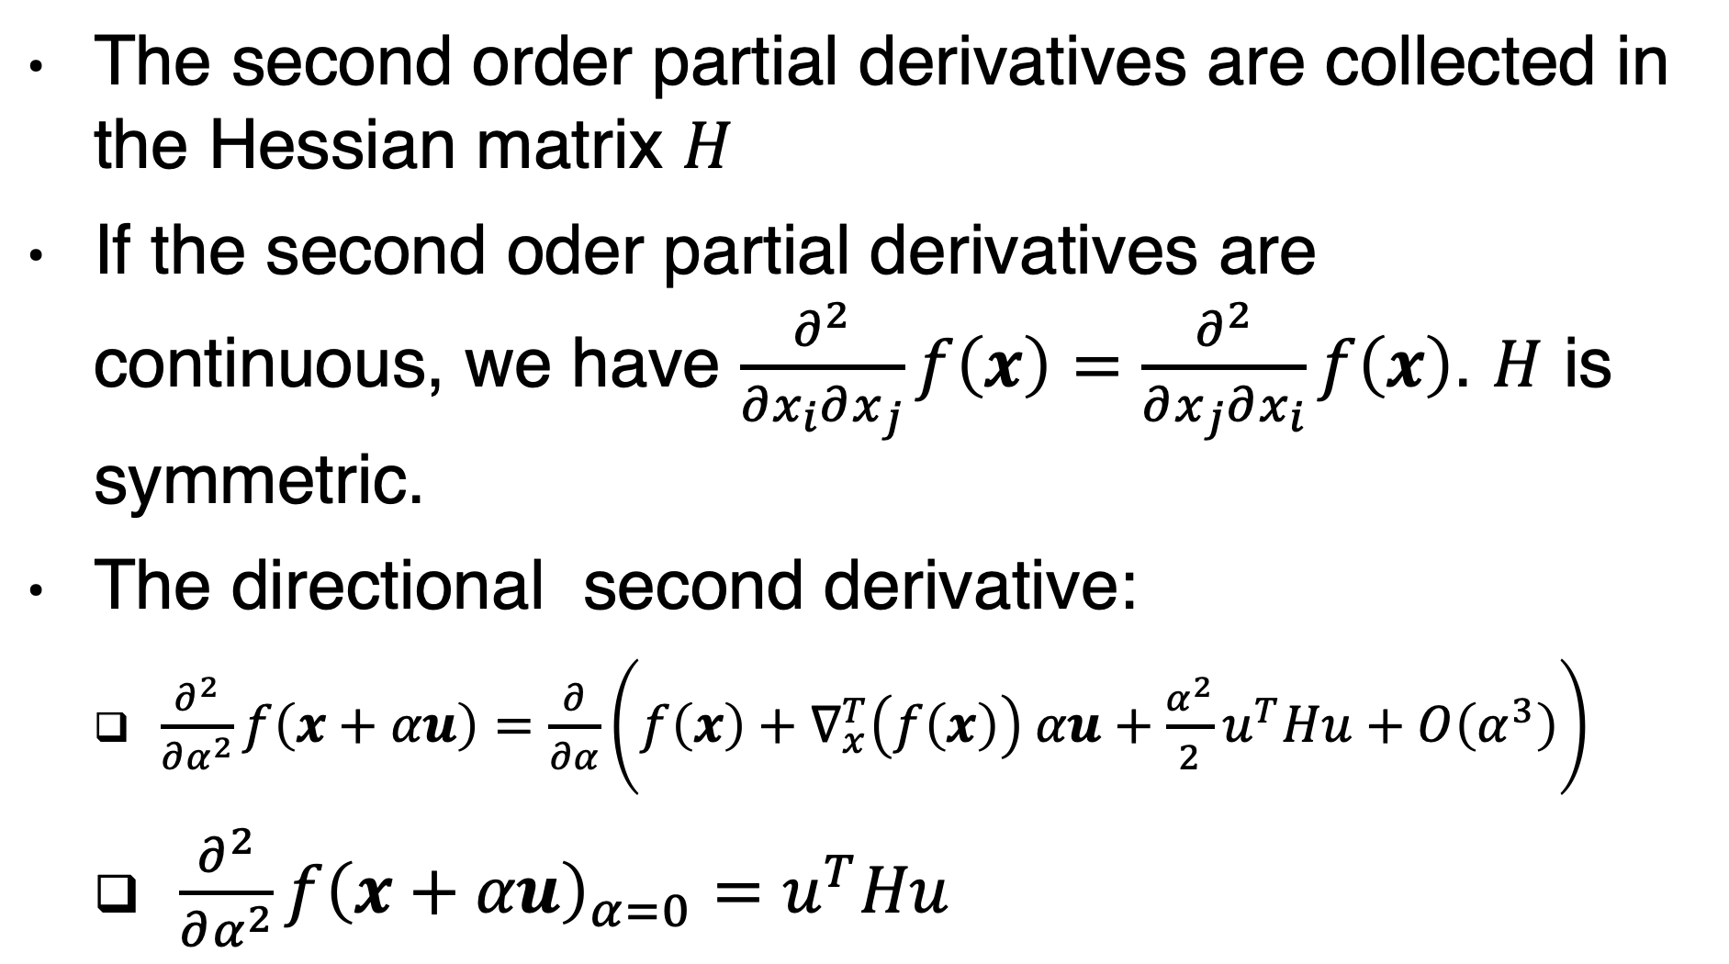
Second derivative – multiple dimensions
The second order partial derivatives are collected in the Hessian matrix $H$
If the second oder partial derivatives are continuous, we have $\frac{∂^{2}}{∂x_{i}∂x_{j}}f\left(x\right)=\frac{∂^{2}}{∂x_{j}∂x_{i}}f\left(x\right)$. $H$ is symmetric.
The directional second derivative:
$\frac{∂^{2}}{∂α^{2}}f\left(x+αu\right)=\frac{∂}{∂α}\left(f\left(x\right)+∇_{x}^{T}\left(f\left(x\right)\right) αu+\frac{α^{2}}{2}u^{T}Hu+O\left(α^{3}\right)\right)$
$\frac{∂^{2}}{∂α^{2}}f{\left(x+αu\right)}_{α=0}=$ $u^{T}Hu$

Slide 19
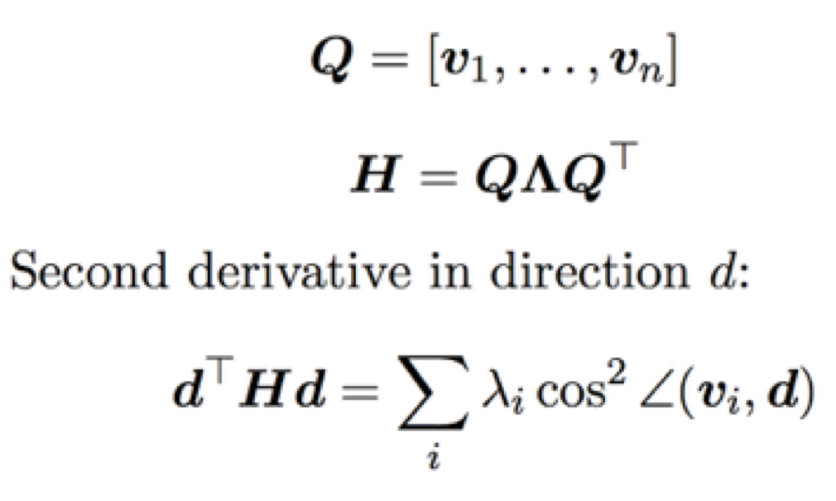
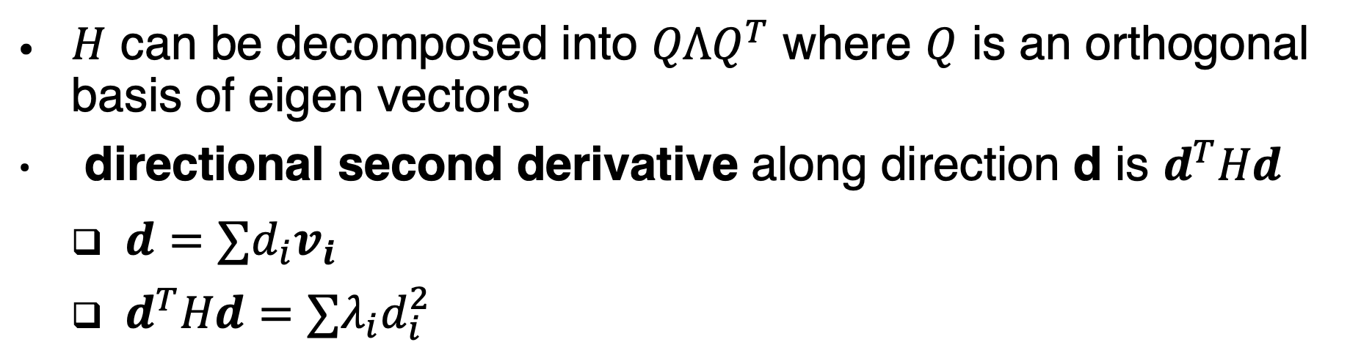
Directional Second Derivatives
$H$ can be decomposed into $QΛQ^{T}$ where $Q$ is an orthogonal basis of eigen vectors
directional second derivative along direction d is $d^{T}Hd$
$d=∑d_{i}v_{i}$
$d^{T}Hd=∑λ_{i}d_{i}^{2}$
The maximum eigen value determines the maximum second derivative
The minimum eigen value determines the minumum second derivative

Slide 20
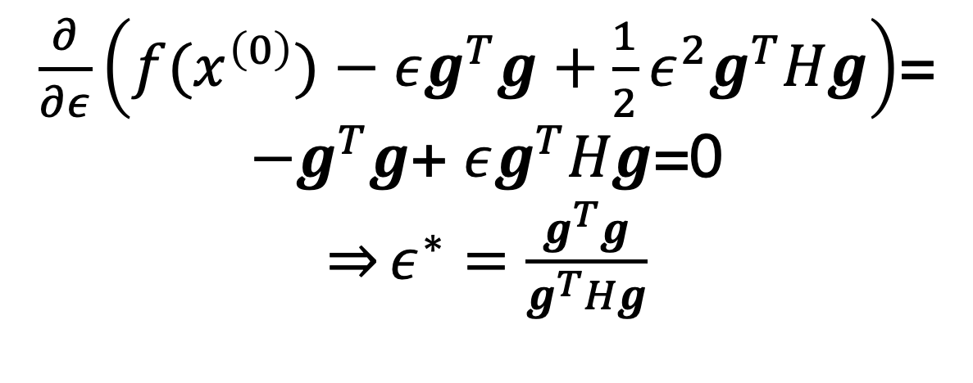
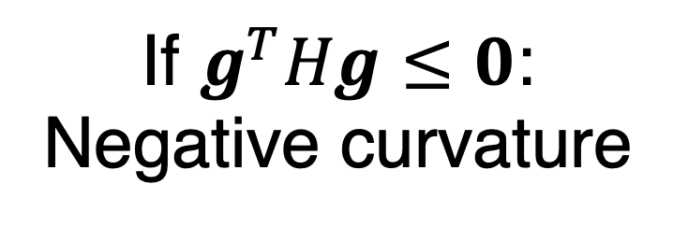
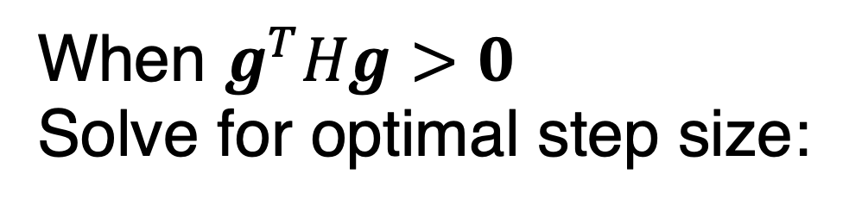
Predicting optimal step size using Taylor series
Expected
improvement
Correction
term
When $g^{T}Hg>0$
Solve for optimal step size:
If $g^{T}Hg≤0$:
Negative curvature
$\frac{∂}{∂ε}\left(f(x^{\left(0\right)})−εg^{T}g+\frac{1}{2}ε^{2}g^{T}Hg\right)$= ${−g}^{T}g$+ $εg^{T}Hg$=0
$\overset{⇒}{}ε^{∗}=$ $\frac{g^{T}g}{g^{T}Hg}$

Slide 21
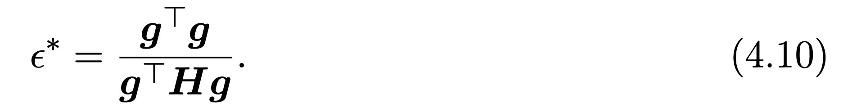
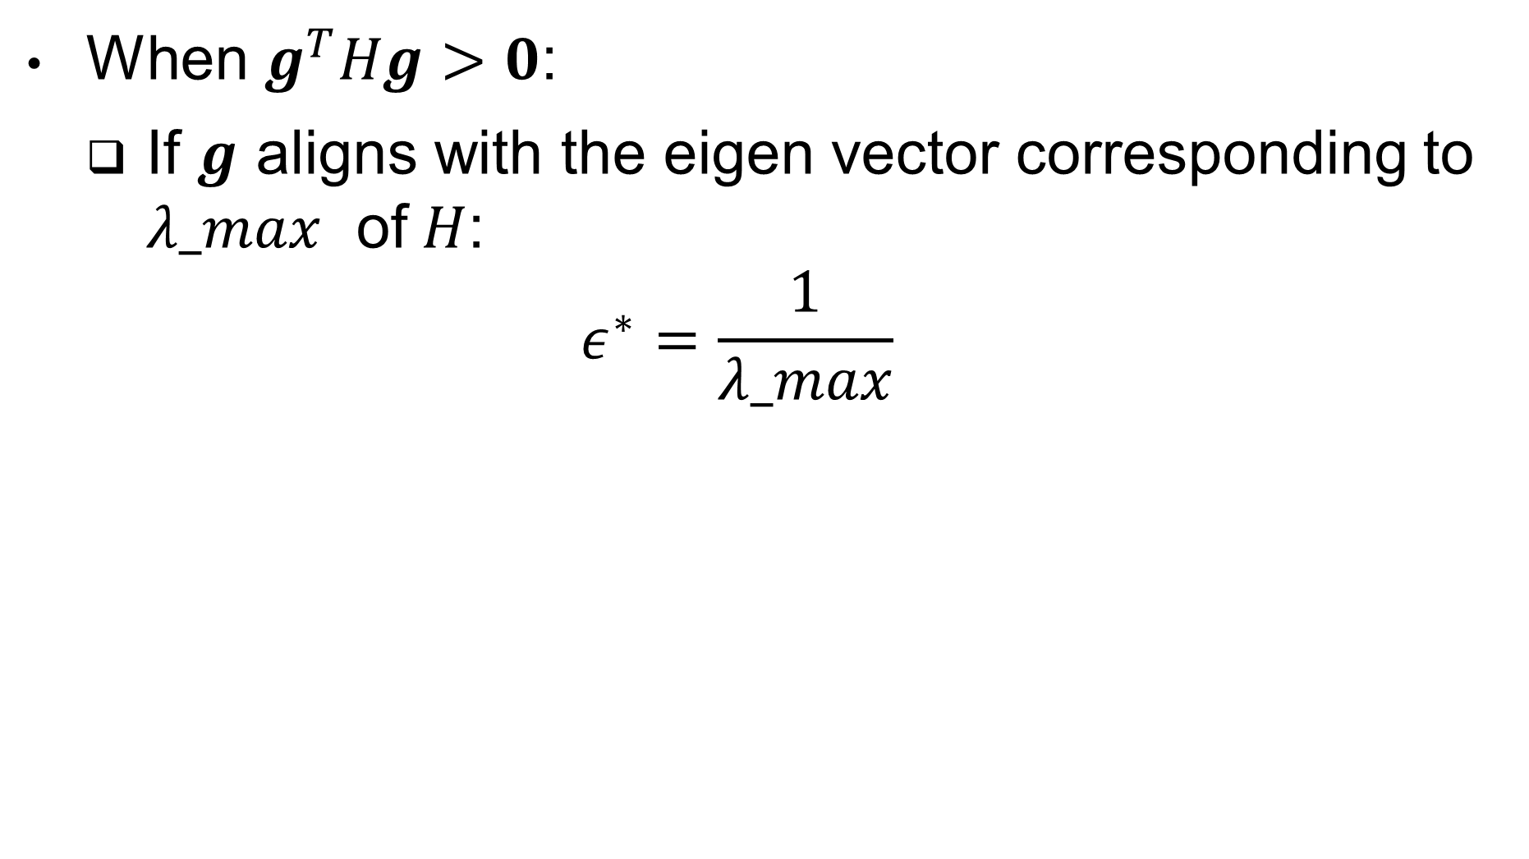
Optimal step
When $g^{T}Hg>0$:
If $g$ aligns with the eigen vector corresponding to $λ_max$ of$H$:
$$ε^{∗}=\frac{1}{λ_max}$$
Big gradients speed you up
Big eigenvalues slow you down if you align with their eigenvectors

Slide 22
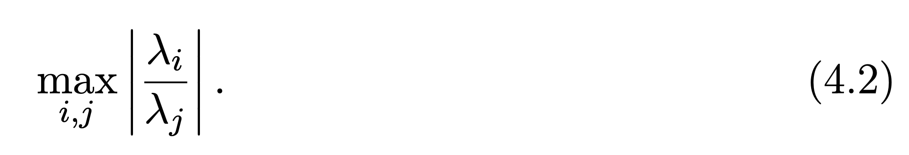
Condition Number
When the condition number is large,
sometimes you hit large eigenvalues and sometimes you hit small ones.
The large ones force you to keep the learning rate small, and miss out on moving fast in the small eigenvalue directions.

Slide 23
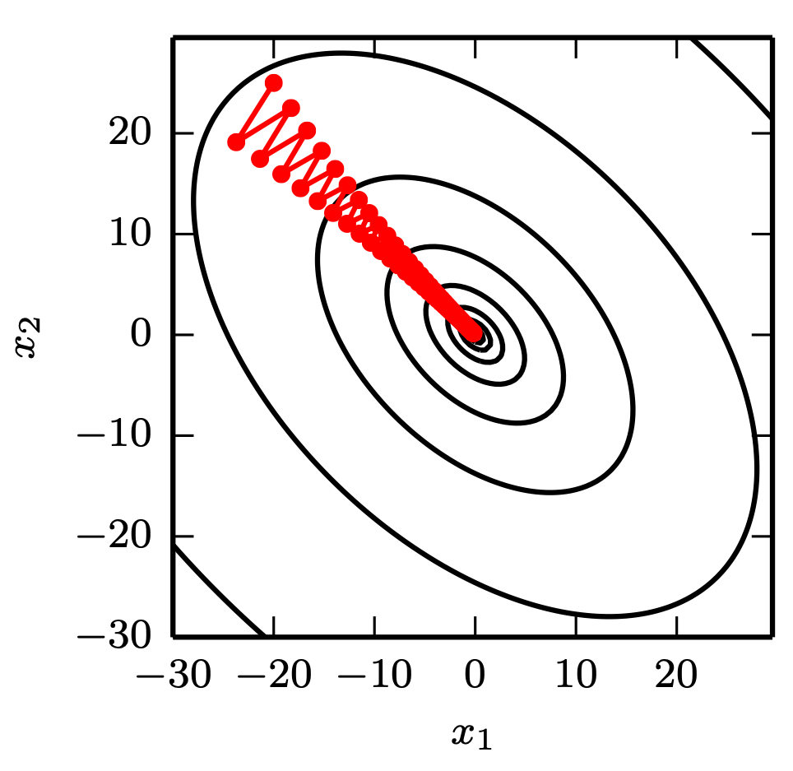
Gradient Descent and Poor Conditioning
Figure 4.6

Slide 24
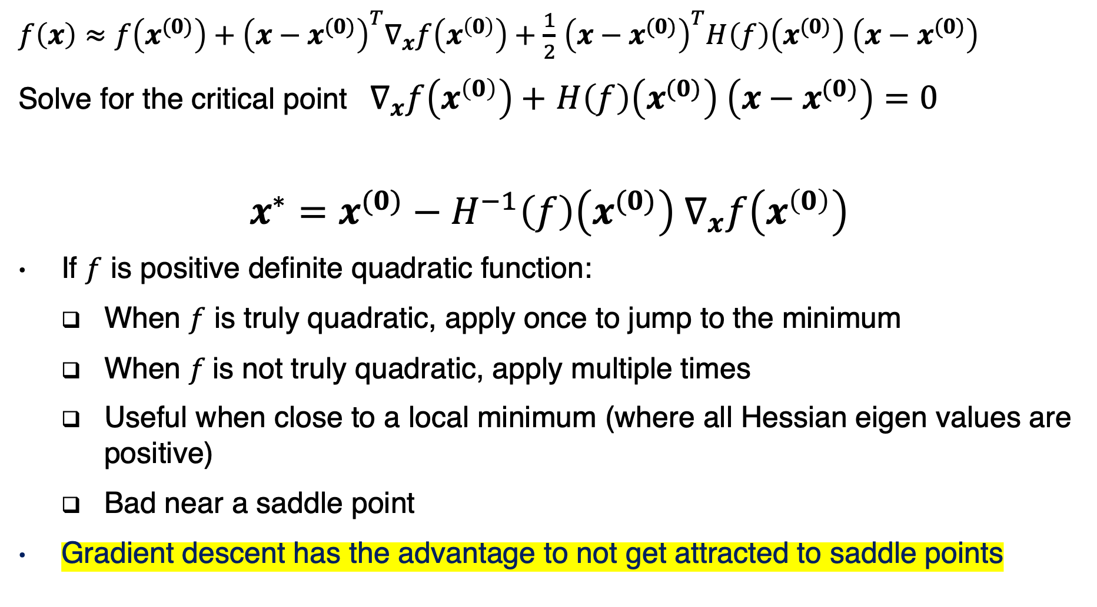
Newton’s Method
$f\left(x\right)≈f\left(x^{(0)}\right)+{\left(x−x^{(0)}\right)}^{T}∇_{x}f\left(x^{\left(0\right)}\right)+\frac{1}{2}$ ${\left(x−x^{(0)}\right)}^{T}H\left(f\right)\left(x^{(0)}\right) \left(x−x^{(0)}\right)$
Solve for the critical point${ ∇}_{x}f\left(x^{\left(0\right)}\right)+$ $H\left(f\right)\left(x^{(0)}\right) \left(x−x^{(0)}\right)=0$
$$x^{∗}=x^{(0)}−{H^{−1}\left(f\right)\left(x^{(0)}\right) ∇}_{x}f\left(x^{\left(0\right)}\right)$$
If $f$ is positive definite quadratic function:
When $f$ is truly quadratic, apply once to jump to the minimum
When $f$is not truly quadratic, apply multiple times
Useful when close to a local minimum (where all Hessian eigen values are positive)
Bad near a saddle point
Gradient descent has the advantage to not get attracted to saddle points

Slide 25
Iterative Optimization
Gradient descent
Curvature
Constrained optimization

Slide 26
KKT Multipliers
In this book, mostly used for theory
(e.g.: show Gaussian is highest entropy distribution)
In practice, we usually
just project back to the
constraint region after each step

Slide 27
Roadmap
Iterative Optimization
Rounding error, underflow, overflow

Slide 28
Numerical Precision: A deep learning super skill
Often deep learning algorithms “sort of work”
Loss goes down, accuracy gets within a few percentage points of state-of-the-art
No “bugs” per se
Often deep learning algorithms “explode” (NaNs, large values)
Culprit is often loss of numerical precision

Slide 29
Rounding and truncation errors
In a digital computer, we use float32 or similar schemes to represent real numbers
A real number x is rounded to x + delta for some small delta
Overflow: large x replaced by inf
Underflow: small x replaced by 0

Slide 30
Example
Adding a very small number to a larger one may have no effect. This can cause large changes downstream:
>>> a = np.array([0., 1e-8]).astype('float32')
>>> a.argmax()
1
>>> (a + 1).argmax()
0

Slide 31
Secondary effects
Suppose we have code that computes x-y
Suppose x overflows to inf
Suppose y overflows to inf
Then x - y = inf - inf = NaN

Slide 32
exp
exp(x) overflows for large x
Doesn’t need to be very large
float32: 89 overflows
Never use large x
exp(x) underflows for very negative x
Possibly not a problem
Possibly catastrophic if exp(x) is a denominator, an argument to a logarithm, etc.

Slide 33
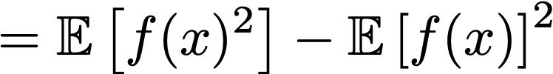
Subtraction
Suppose x and y have similar magnitude
Suppose x is always greater than y
In a computer, x - y may be negative due to rounding error
Example: variance
Safe
Dangerous

Slide 34
log and sqrt
log(0) = - inf
log(<negative>) is imaginary, usually nan in software
sqrt(0) is 0, but its derivative has a divide by zero
Definitely avoid underflow or round-to-negative in the argument!
Common case: standard_dev = sqrt(variance)

Slide 35
log exp
log exp(x) is a common pattern
Should be simplified to x
Avoids:
Overflow in exp
Underflow in exp causing -inf in log

Slide 36
Which is the better hack?
normalized_x = x / st_dev
eps = 1e-7
Should we use
st_dev = sqrt(eps + variance)
or st_dev = eps + sqrt(variance) ?
What if variance is implemented safely and will never round to negative?
Notes:
First one is better but make sure eps is big enough such that sqrt (eps) is not 0. In the second scenario sqrt(variance) may be rounded to 0 , and this can cause a division by 0 in the derivative of st_dev!

Slide 37
log(sum(exp))
Naive implementation: tf.log(tf.reduce_sum(tf.exp(array))
Failure modes:
If any entry is very large, exp overflows
If all entries are very negative, all exps underflow… and then log is -inf

Slide 38
Stable version
mx = tf.reduce_max(array)
safe_array = array - mx
log_sum_exp = mx + tf.log(tf.reduce_sum(exp(safe_array))
Built in version:
tf.reduce_logsumexp

Slide 39
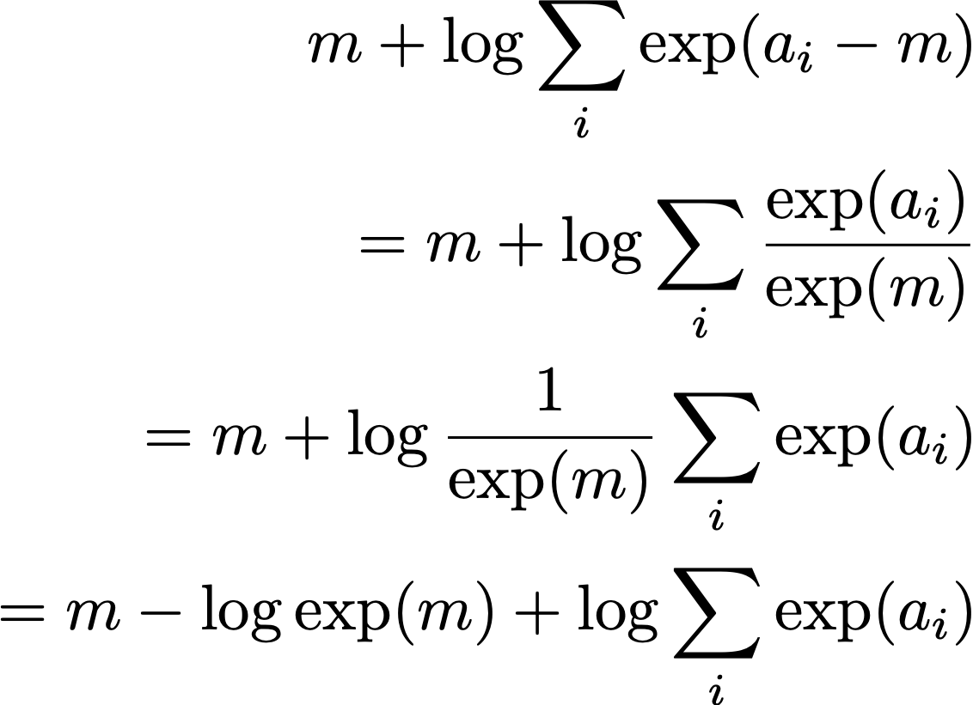
Why does the logsumexp trick work?
Algebraically equivalent to the original version:

Slide 40
Why does the logsumexp trick work?
No overflow:
Entries of safe_array are at most 0
Some of the exp terms underflow, but not all
At least one entry of safe_array is 0
The sum of exp terms is at least 1
The sum is now safe to pass to the log

Slide 41
Softmax
Softmax: use your library’s built-in softmax function
If you build your own, use:
Similar to logsumexp
safe_logits = logits - tf.reduce_max(logits)
softmax = tf.nn.softmax(safe_logits)

Slide 42
Cross-entropy
Cross-entropy loss for softmax (and sigmoid) has both softmax and logsumexp in it
Compute it using the logits not the probabilities
The probabilities lose gradient due to rounding error where the softmax saturates
Use tf.nn.softmax_cross_entropy_with_logits or similar
If you roll your own, use the stabilization tricks for softmax and logsumexp

Slide 43
Sigmoid
Use your library’s built-in sigmoid function
If you build your own:
Recall that sigmoid is just softmax with one of the logits hard-coded to 0

Slide 44
Bug hunting strategies
If you increase your learning rate and the loss gets stuck, you are probably rounding your gradient to zero somewhere: maybe computing cross-entropy using probabilities instead of logits
For correctly implemented loss, too high of learning rate should usually cause explosion

Slide 45
Bug hunting strategies
If you see explosion (NaNs, very large values) immediately suspect:
log
exp
sqrt
division
Always suspect the code that changed most recently

Slide 46
Watch
https://www.youtube.com/watch?v=XlYD8jn1ayE&list=PLoWh1paHYVRfygApBdss1HCt-TFZRXs0k

